Slide 1
HealthCare Dataset Analysis Using Python
By Jayanthar S
DADS – JULY

Slide 2
Cleaning Process
Removed notes column from the dataset
Verified and modified all data types
Separated year into individual year column

Slide 3
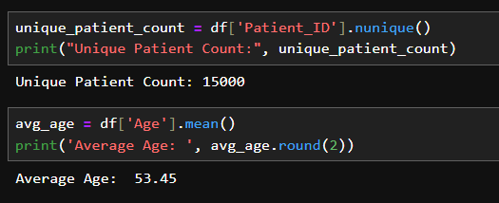
Unique patient counts &
Average AGE OF CUSTOMERS

Slide 4
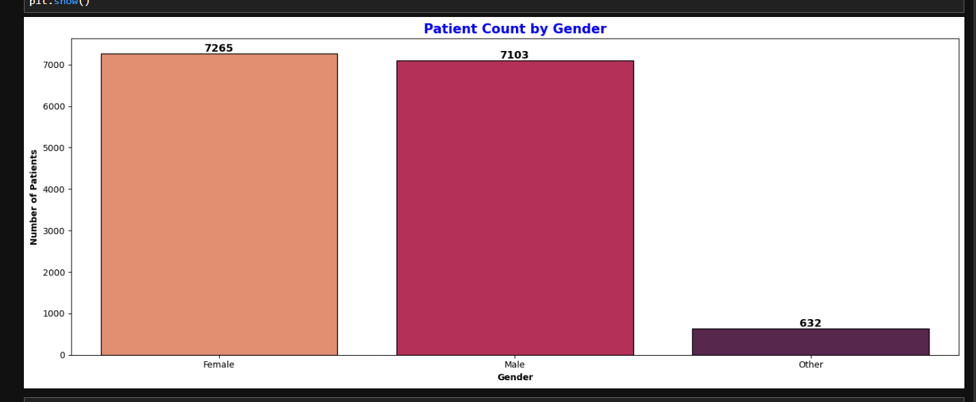
Patient Count by Gender

Slide 5
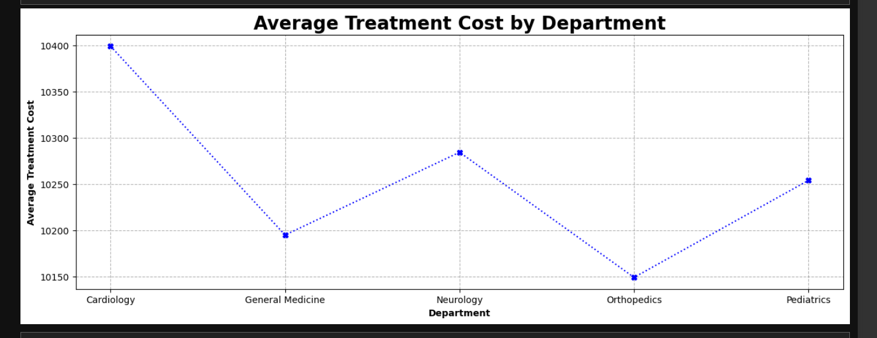
Average Treatment Cost by Department

Slide 6
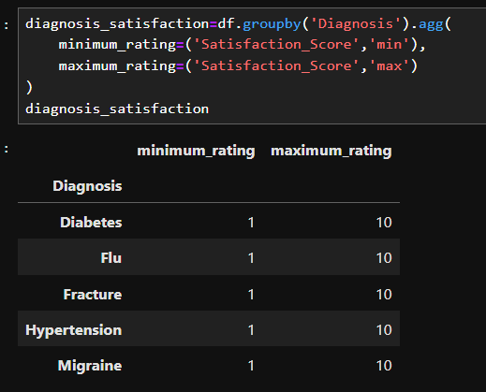
Diagnosis satisfaction score per department

Slide 7
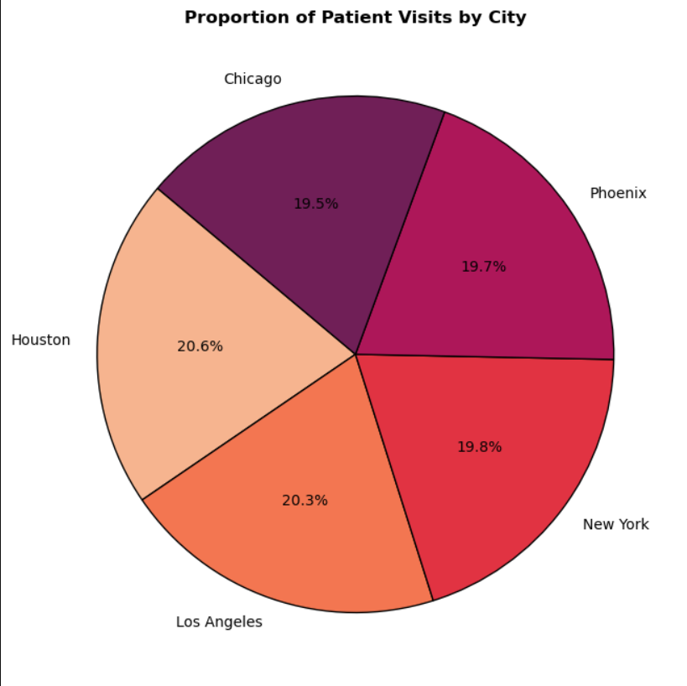
Patients visits per city

Slide 8
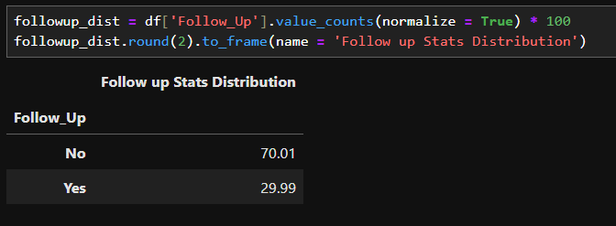
Follow up distribution

Slide 9
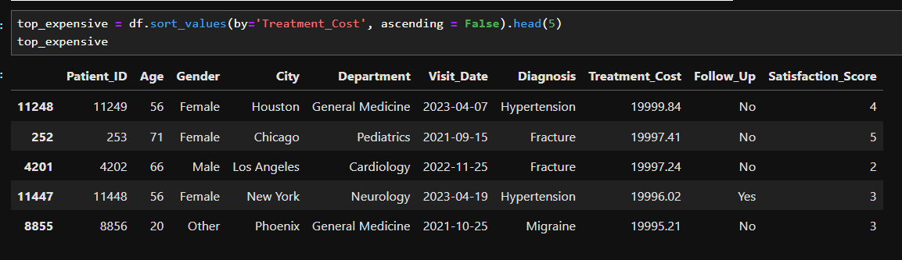
Top 5 expensive treatment cost

Slide 10
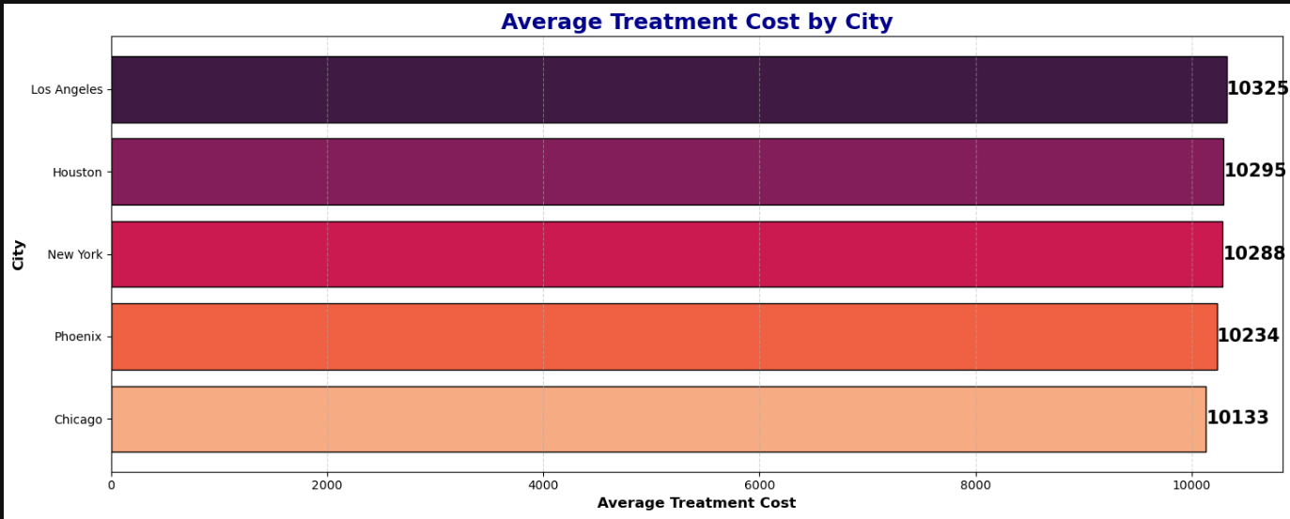
Treatment Cost Per city

Slide 11
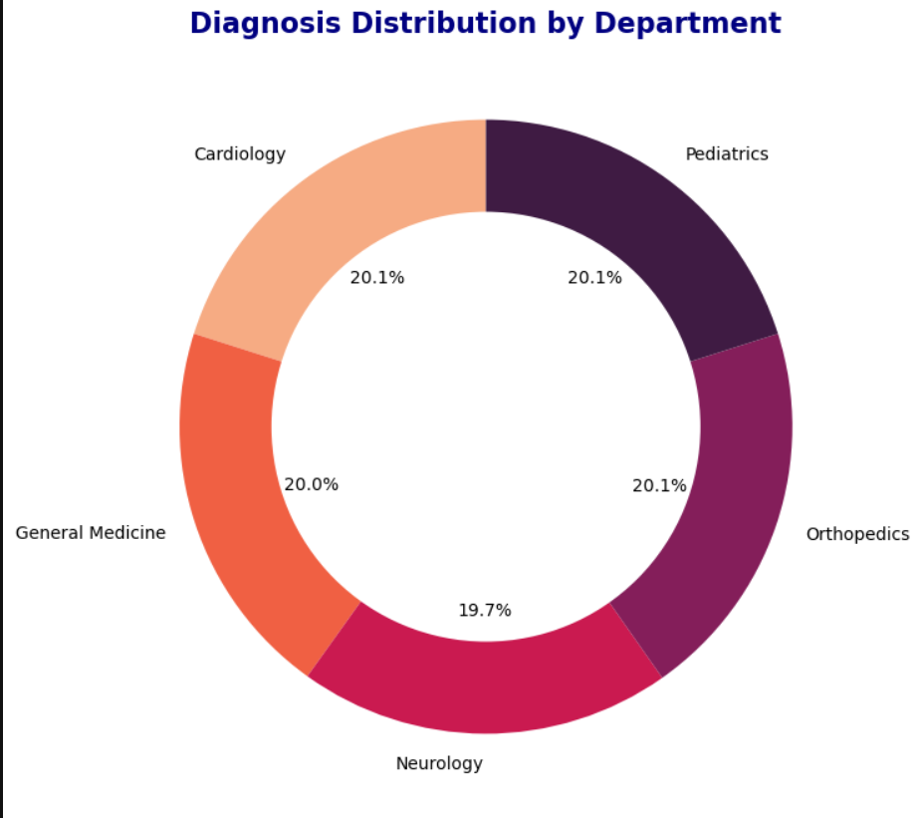
Diagnosis
Distribution

Slide 12
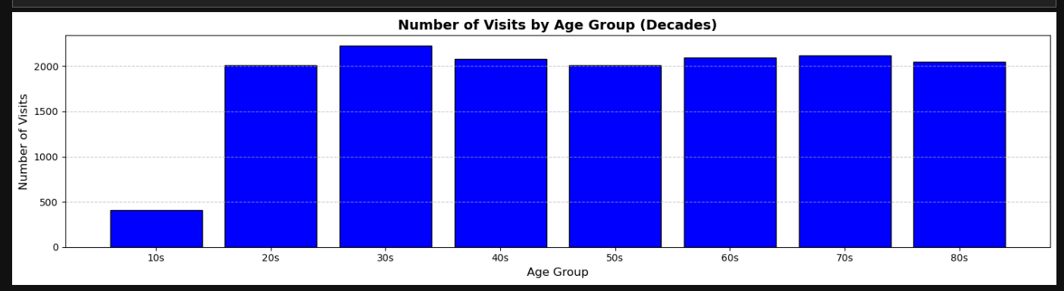
Number of visits by age group

Slide 13

THANK YOU

